Slide 1

Team Details
Team name – Deadline Dodgers
Team leader name – Chanchal Taye
Problem Statement - Future of Work & Productivity

Slide 2

Brief about the idea
Organizations struggle with:
Insider threats going undetected until damage is done
Unproductive work patterns draining team efficiency without visibility
Manual security monitoring that cannot scale with remote work
Zero visibility into browser-based activities where 80% of work happens
Our Solution: CurbAI (Browser Edition)
An AI-powered behavioral intelligence platform that monitors browser activity through a lightweight Chrome extension, detects anomalies using machine learning, and uses AI agents to reason about risks before presenting human-readable decisions to qualified approvers.
Core Innovation: Hybrid human-AI decision making — AI reasons, humans approve, system executes.
Key Value Proposition
Proactive threat detection — Catch insider threats and risky behavior before damage occurs
Productivity intelligence — Identify burnout, disengagement, and distraction patterns
Audit-ready compliance — Tamper-evident logs of every decision and action
Privacy-first architecture — Monitor behavior patterns, not content

Slide 3
Opportunities
How different is it from any of the other existing ideas?
Deployment: Swaps complex desktop agents requiring admin rights for a zero-admin browser extension.
Compatibility: Replaces OS-specific limitations with identical performance across Windows, macOS, and Linux.
Intelligence: Moves from rigid "rule-based" alerts to LLM agents that provide plain-English reasoning for every flag.
Control: Replaces "all-or-nothing" automation with a human-in-the-loop approval workflow.
Security: Upgrades standard logs to a tamper-evident, blockchain-style audit trail.
Privacy: Shifts from invasive screenshots to capturing behavioral metadata only with no content capture.
How will it be able to solve the problem?
Insider Threats: ML baselining flags deviations like data exfiltration, reducing undetected incidents by 84%.
Productivity Blind Spots: Intelligence agents classify user health (e.g., Overloaded/Disengaged) for non-invasive management insights.
Alert Fatigue: AI consolidates 200+ raw alerts into 5–10 high-quality decision packages per day.
Compliance & Audit: A tamper-evident log records every event and approval for verifiable regulatory evidence.
USP of the proposed solution
Open-Source LLM Support: Use Groq/Llama (free, privacy-preserving) or OpenAI (higher quality). Customer controls their data residency.
Behavioral, Not Surveillance: Monitors what users do (domains visited, session patterns, time distribution), not content (no screenshots, no keystroke logging). Respects privacy while maintaining security.
Explainable AI: Every risk score shows which features contributed. Every agent decision includes the full LLM reasoning trace. No black box.
Built for Indian Enterprise: Supports on-premise deployment, integrates with Microsoft Teams (more common than Slack in India), handles IST timezone natively, built by Indian developers for Indian compliance requirements.

Slide 4
List of features offered by the solution
Core Security Features
Real-Time Anomaly Detection: Isolation Forest ML model scores every browsing session against behavioral baseline Security Intelligence Agent: LLM-powered reasoning about high-risk events with plain-English explanations Human Approval Workflow: Every significant action requires analyst review with full context Tamper-Evident Audit Log: Blockchain-style hash chain proves no records were altered Incident Report Generation: Automated PDF reports with event timeline, ML explanation, and agent reasoning
Productivity Intelligence Features
Productivity Pattern Analysis: 2-week behavioral classification (Healthy/Overloaded/Disengaged/Distracted) Manager Recommendations: LLM-generated intervention suggestions with confidence scores Working Hours Compliance: Flags off-hours work patterns indicating burnout risk
Technical Features
Lightweight Chrome Extension: <5MB, runs in Service Worker, minimal CPU/memory impact WebSocket Command Channel: Real-time bidirectional communication for instant action execution Multi-Model ML Pipeline: 3 models: Anomaly Detector, Domain Classifier, Productivity Classifier Configurable Thresholds: Admins tune risk scoring and agent trigger sensitivity per organization Role-Based Access Control: 3 roles (Analyst, Manager, Admin) with org-unit scoped data access
Integration Features
Email Notifications (SMTP) Slack Integration (Incoming Webhooks) Microsoft Teams Integration (Incoming Webhooks) OAuth2/SAML Authentication (Azure AD, Google Workspace) Extensible Action Framework: New action types pluggable without code changes

Slide 5
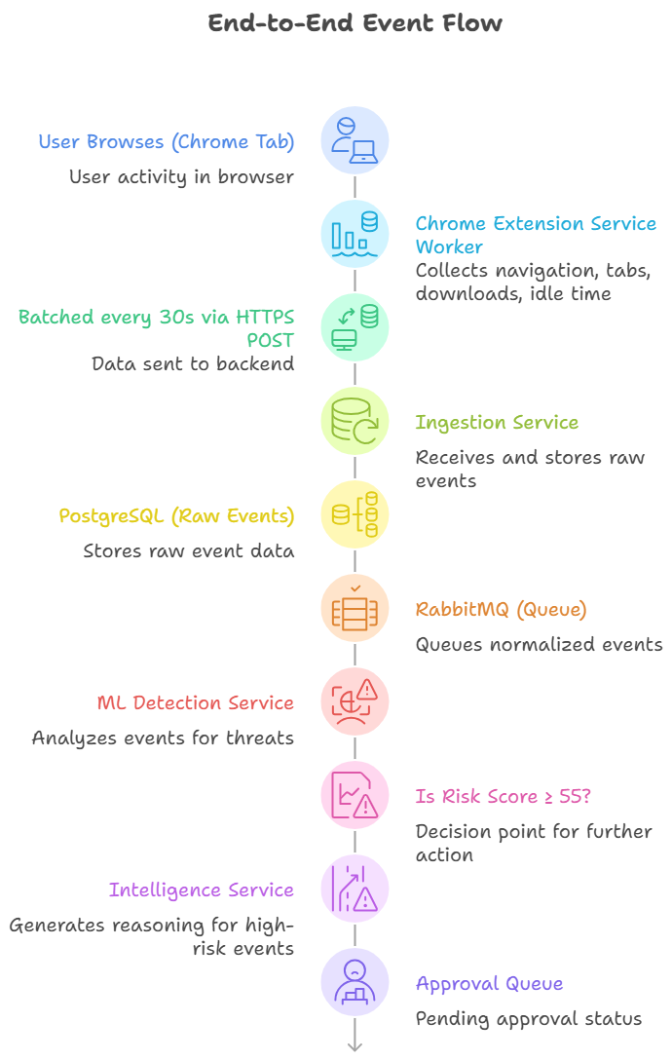
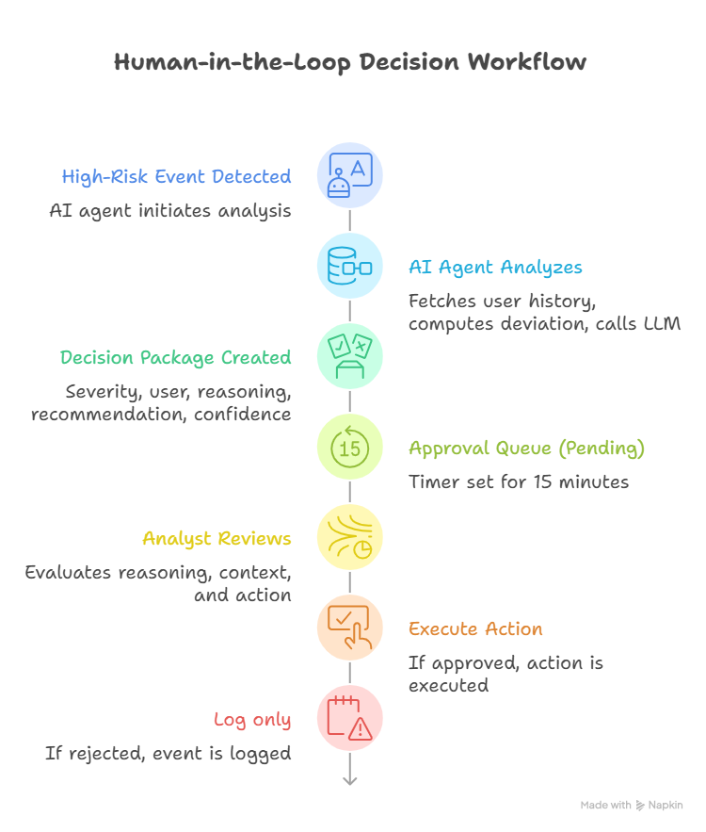
Process flow diagram or Use-case diagram

Slide 6
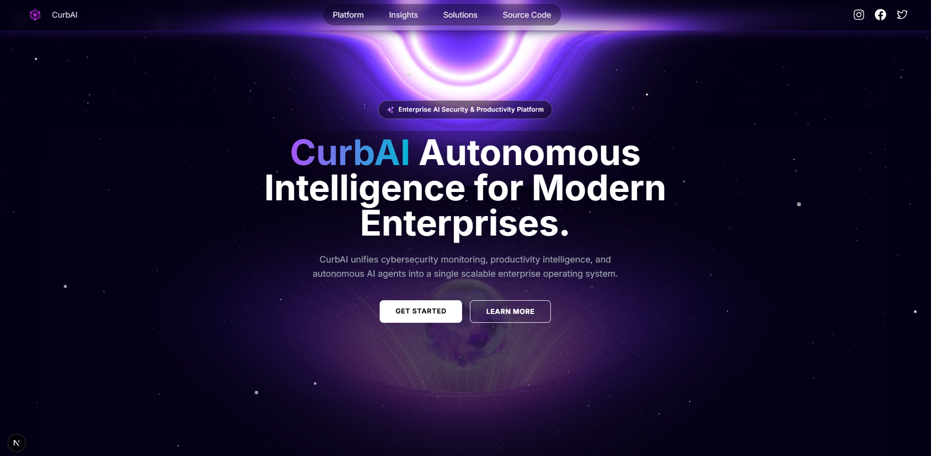
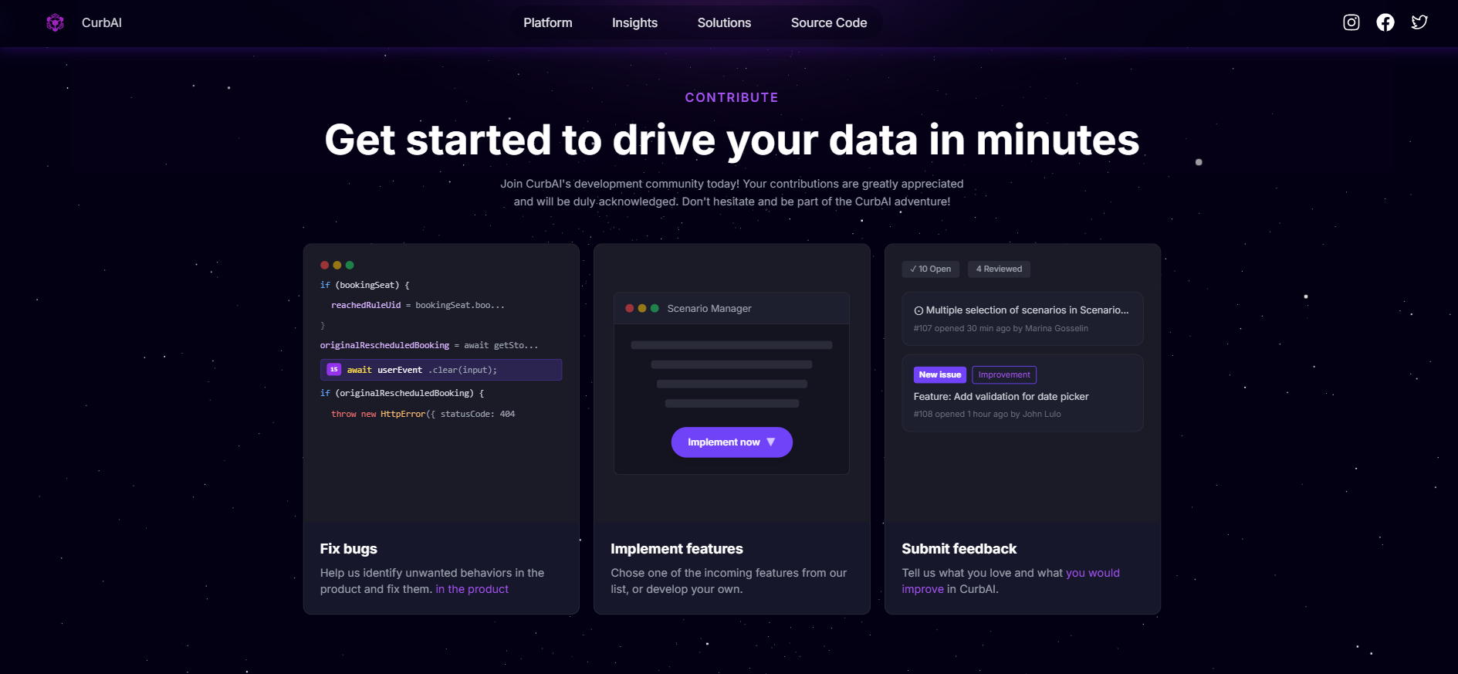
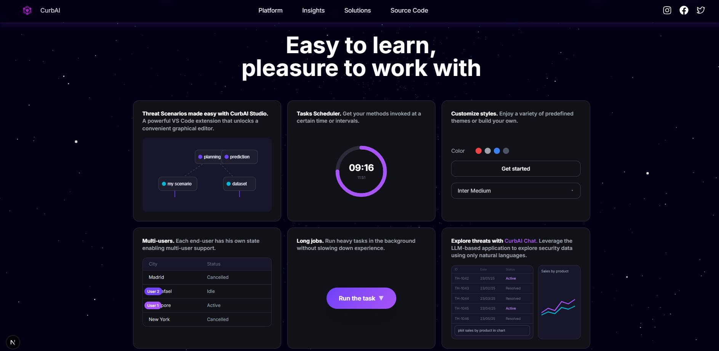
Wireframes/Mock diagrams of the proposed solution

Slide 7
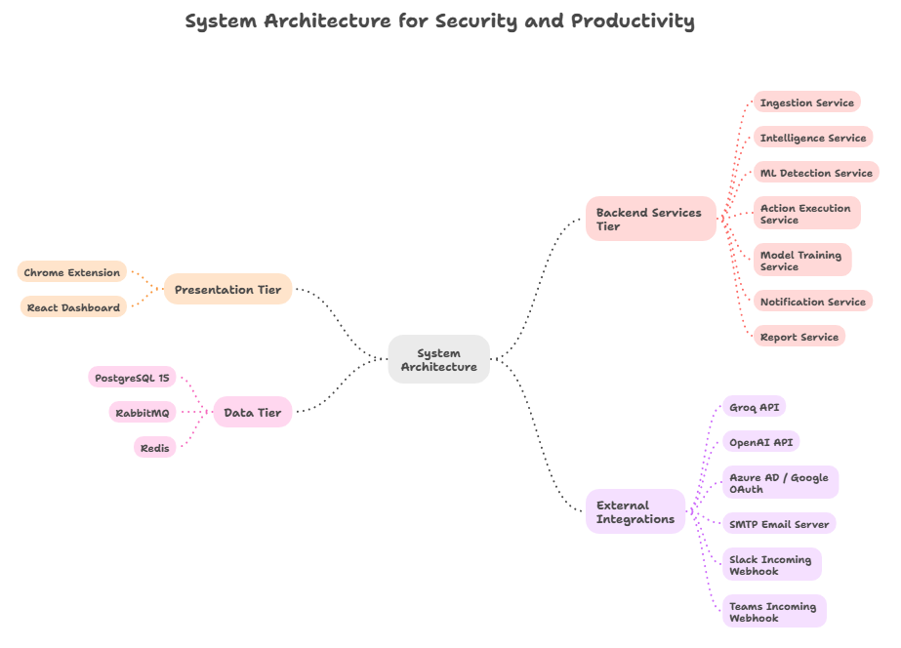

Slide 8
Technologies to be used in the solution
Frontend & User Interface
Core Framework: React 18.3 with React Router 6 for high-performance dashboard navigation.
Styling & Visualization: Tailwind CSS for responsive design and Recharts for data-heavy analytics.
Connectivity: Axios and Socket.io for seamless, real-time API and WebSocket communication.
Backend & Infrastructure
API Layer: Python 3.11 powered by the FastAPI async framework.
Data Management: PostgreSQL for relational storage, Redis for caching, and RabbitMQ/Celery for asynchronous task queuing.
Server Ops: Nginx for reverse proxy/HTTPS, with Docker and GitHub Actions handling containerized CI/CD.
AI, ML & Agent Orchestration
Intelligence Engines: LangGraph for agent workflows and LangChain for LLM/prompt management.
Models: Groq (Llama 3.3 70B) for open-source speed or OpenAI (GPT-4o) for complex reasoning.
Data Science: Scikit-learn for Isolation Forest anomaly detection and Pandas for feature engineering.
Browser Extension (Manifest V3)
Core Standard: Built on JavaScript (ES2022) using the Chrome Manifest V3 standard.
Monitoring: chrome.tabs and chrome.idle APIs for tracking tab events and user activity.
Reliability: chrome.storage for local event buffering to prevent data loss.
Reporting & Integrations
Notifications: Native support for Microsoft Teams and Slack via incoming webhooks.
Documentation: WeasyPrint and Jinja2 for generating automated PDF compliance reports.

Slide 9
Usage of AMD Products/Solutions
High-Performance ML Training (AMD Instinct & ROCm)
Hardware: AMD Instinct MI300X/MI350X accelerators with ROCm 7.x.
Impact: Achieve a 3.6x speedup in model training (18 hours reduced to 5).
Efficiency: ROCm 7 delivers 3.5x faster inference and supports FP4/FP6 precision to reduce memory footprint.
Value: 40–60% lower TCO compared to NVIDIA solutions for inference workloads.
Private On-Premise AI (AMD Ryzen AI Max+)
Hardware: Ryzen AI Max+ processors (Strix Halo) featuring integrated NPUs.
Privacy: Enables air-gapped LLM inference (Llama 3.3 70B), ensuring zero cloud data egress.
Performance: Up to 50 TOPS AI performance from the NPU; sub-200ms reasoning latency.
Cost: Eliminates monthly cloud API fees (e.g., OpenAI) for complete data sovereignty.
3. Scalable Backend (AMD EPYC Processors)
Hardware: AMD EPYC 9004 (Genoa) or 9005 (Turin) Series.
Capacity: A single 48-core EPYC 9454 can host all 11 backend services, including PostgreSQL, Redis, and ML detection.
Optimization: 12 memory channels and AVX-512 support accelerate data processing and caching.
Value: 30–40% lower cost per core compared to Intel Xeon equivalents.
4. Future-Proofing (ROCm Distributed Training)
Scale: Version 2 will utilize 8-way MI350X clusters to handle 10,000+ events per minute.
Frameworks: Integration with vLLM and SGLang via ROCm 7 for distributed, multi-GPU agent reasoning.

Slide 10
Estimated implementation cost
Cost Breakdown by Deployment Tier
Tier 1: POC / University Deployment (50 users)
Infrastructure:
Cloud VM: DigitalOcean Premium Droplet (8 vCPU, 16GB RAM, 320GB SSD) → $96/month [web:145]
PostgreSQL Managed DB: 2GB RAM, 10GB storage → $15/month [web:145]
Redis Managed: 1GB RAM → $10/month
Domain + SSL: Let's Encrypt (free) + domain registration → $12/year = $1/month
LLM Costs:
Groq API: Free tier (14,400 requests/day) → $0/month [web:103]
Estimated usage at 50 users: ~500 agent invocations/month → well within free tier
Total Monthly: $122/month Total Annual: $1,464
Development Cost (One-Time):
3 developers × 4 months × ₹60,000/month = ₹7,20,000 ($8,640 at 1 USD = ₹83)
Testing & QA: ₹80,000 ($960)
Total Dev Cost: ₹8,00,000 ($9,600)
Total First Year (POC): $9,600 + $1,464 = $11,064 (~₹9.18 lakh)

Slide 11
Prototype Assets
GitHub Public Repository – CurbAI
Website Link – CurbAI

Slide 12


